Slide 1

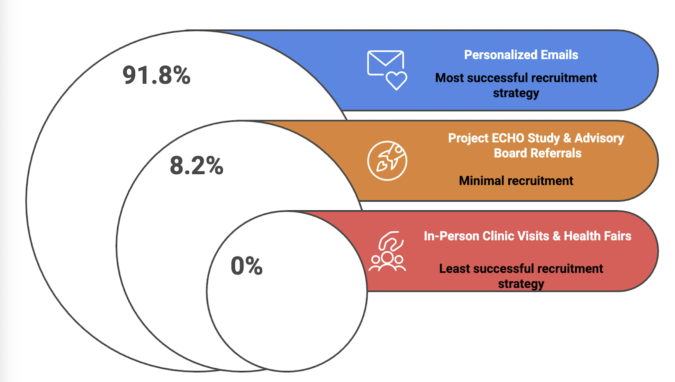

SOARNet: Establishing an Older Adult Practice Based Research Network
Caitlin Sangdahl BS, Sara Masoud PhD MPH, Vidya Sharma PhD RD LD CDCES, Cynthia Sierra MS LPC, Meredith Stensland PhD LMSW, Eduardo Zilli MD, Jennifer LaCoss MD, Angelica Davila MD MS
Background | Methods | Results | Conclusions
Older adults experience worse health outcomes (chronic illness, multimorbidity) Research is needed to improve health care outcomes among older adults, especially among minoritized populations SOARNet established as one of the only PBRNs exclusively focused on the older adult population (AHRQ Database) Members are invited to collaborate on studies, solicit feedback, and recruitment support | Advisory Board established to guide activities and priorities Recruitment via personalized emails, brochures and flyers at clinics, and Leadership and Advisory Board networks Intake form includes 47-items to describe member demographics, affiliation, and populations served | SOARNet members (N=61) include providers(N-34) who collectively serve over 950 patients Recruitment strategies revealed varied success: personalized emails (91.8%), in-person recruitment at clinics and health fairs (0%), Advisory Board referrals (8.2%) One study conducted via SOARNet in first year of operation; one manuscript published¹; one in preparation | Establishing a new PBRN presents challenges including difficulty recruiting members, generating in-network studies, and promoting collaboration among members Future directions for the Network include implementing more research, fostering meaningful opportunities to connect the member base, and to further build a diverse membership
Personalized email outreach to providers and community members proved to be the most effective recruitment strategy for SOARNet.
SOARNet Membership Characteristics
Join SOARNet Today!
Open to Providers, Researchers, and Community Members
/Organizations
1.Sharma, V., [et al.]. (2025). Strengthening primary care through Project ECHO®: Pilot study on nutrition, brain health, and clinician self-efficacy. Journal of Primary Care & Community Health, 16(1), 1–8. https://doi.org/10.1177/21501319251388298

